Slide 1



Webscraping and Sentiment Analysis from reviews of TripAdvisor
by Sergi Alvarez Guasch
March 2022

Slide 2
Purpose
The purpose of the project is to get the data from the website TripAdvisor, to analyze the number of restaurants that are in Barcelona as well as to get the reviews of the restaurant most reviewed/visited by the TripAdvisor users in Barcelona city. Also, we want to analyze the reviews from this restaurant in order to know the overall trend of its customers/TripAdvors users.

Slide 3
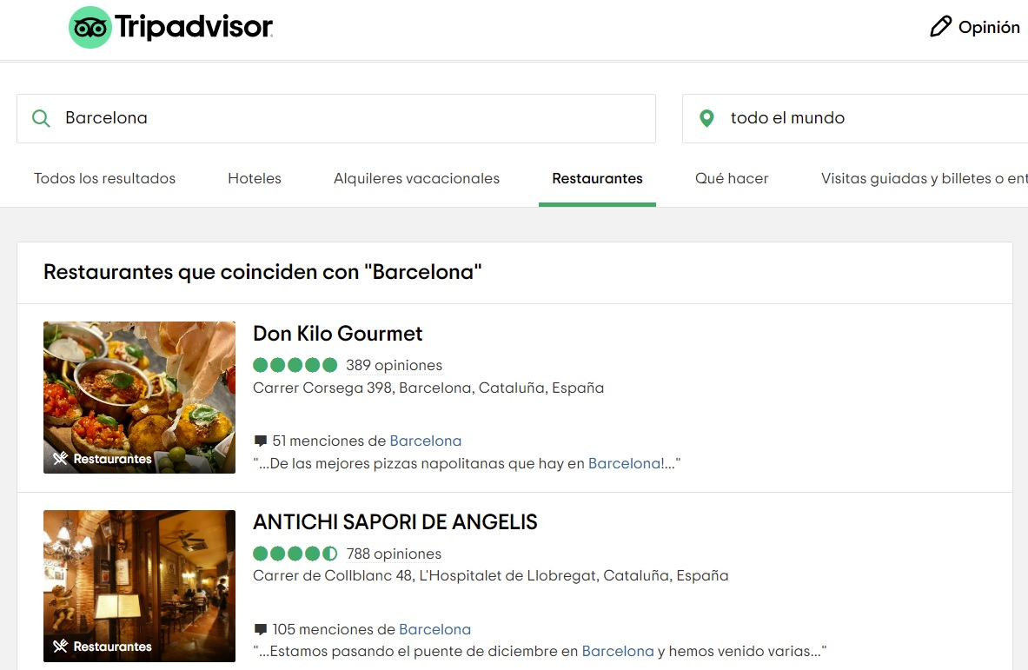
Webscraping

Slide 4
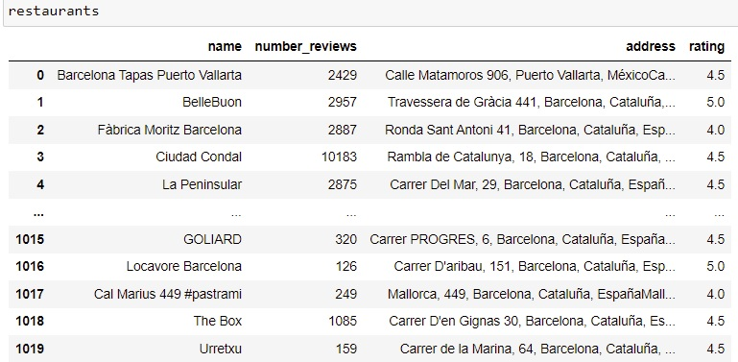
Geocoding
Get the restaurant with the greatest number of reviews
Cleaning Steps
Geocoding

Slide 5
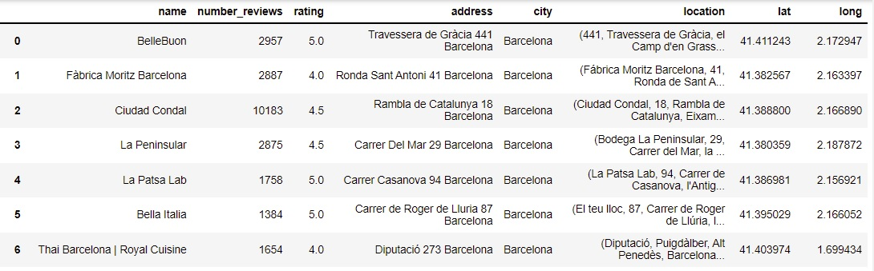
Mapping
Maps/Analysis

Slide 6
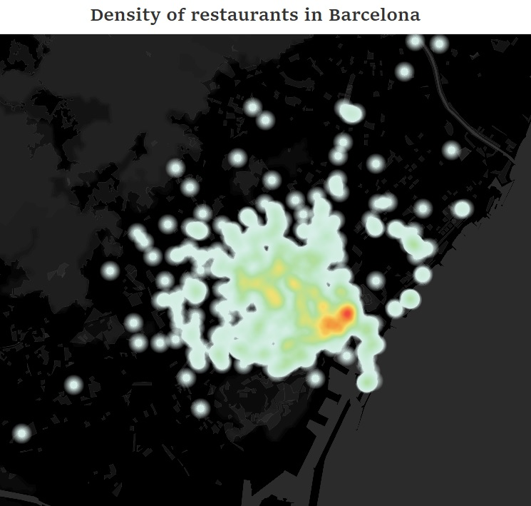

Slide 7
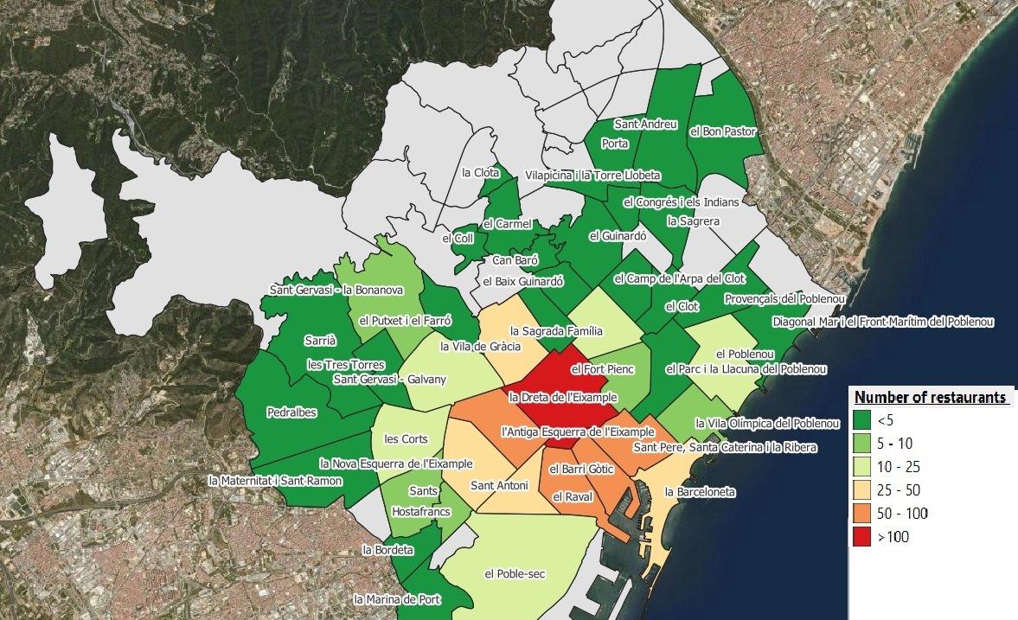
Number of restaurants by neighborhood
Total: 698

Slide 8
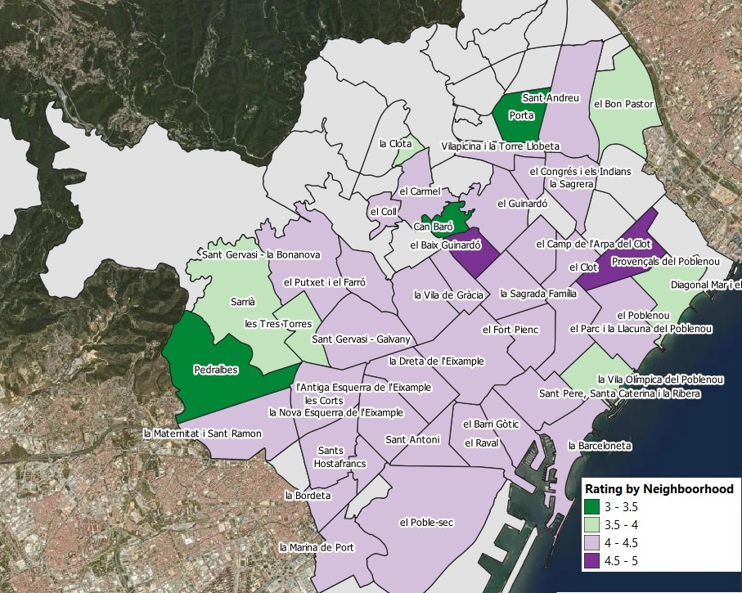
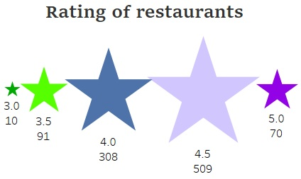
Mean rating review restaurants by neighborhood

Slide 9
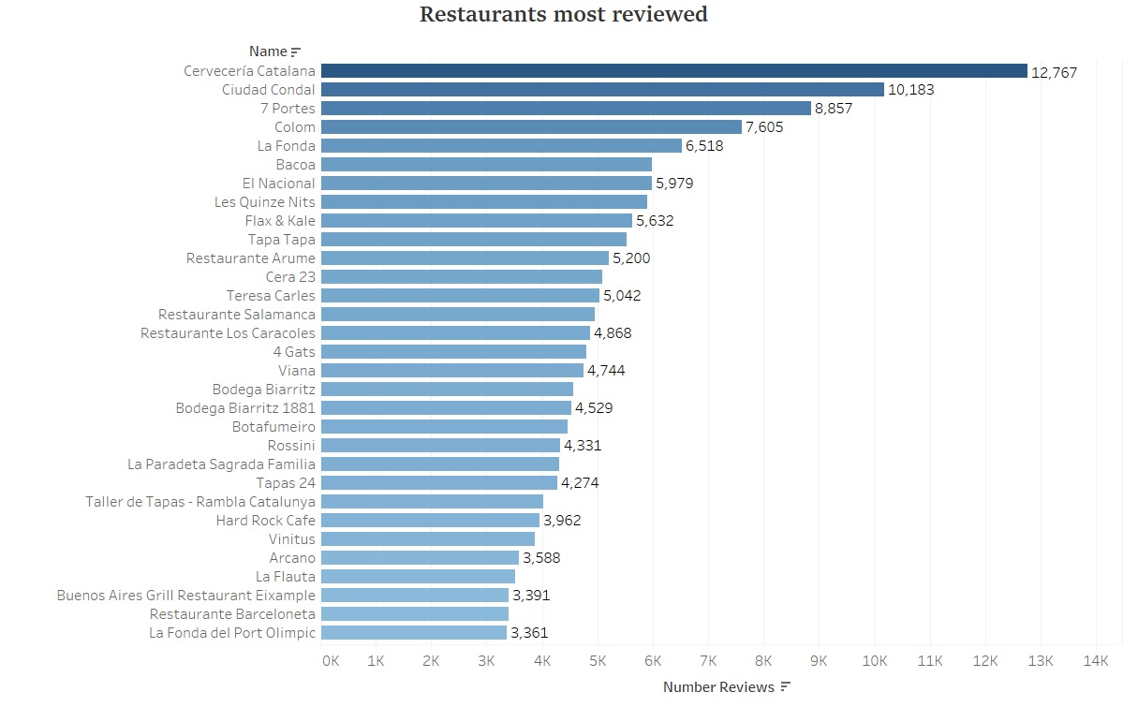

Slide 10
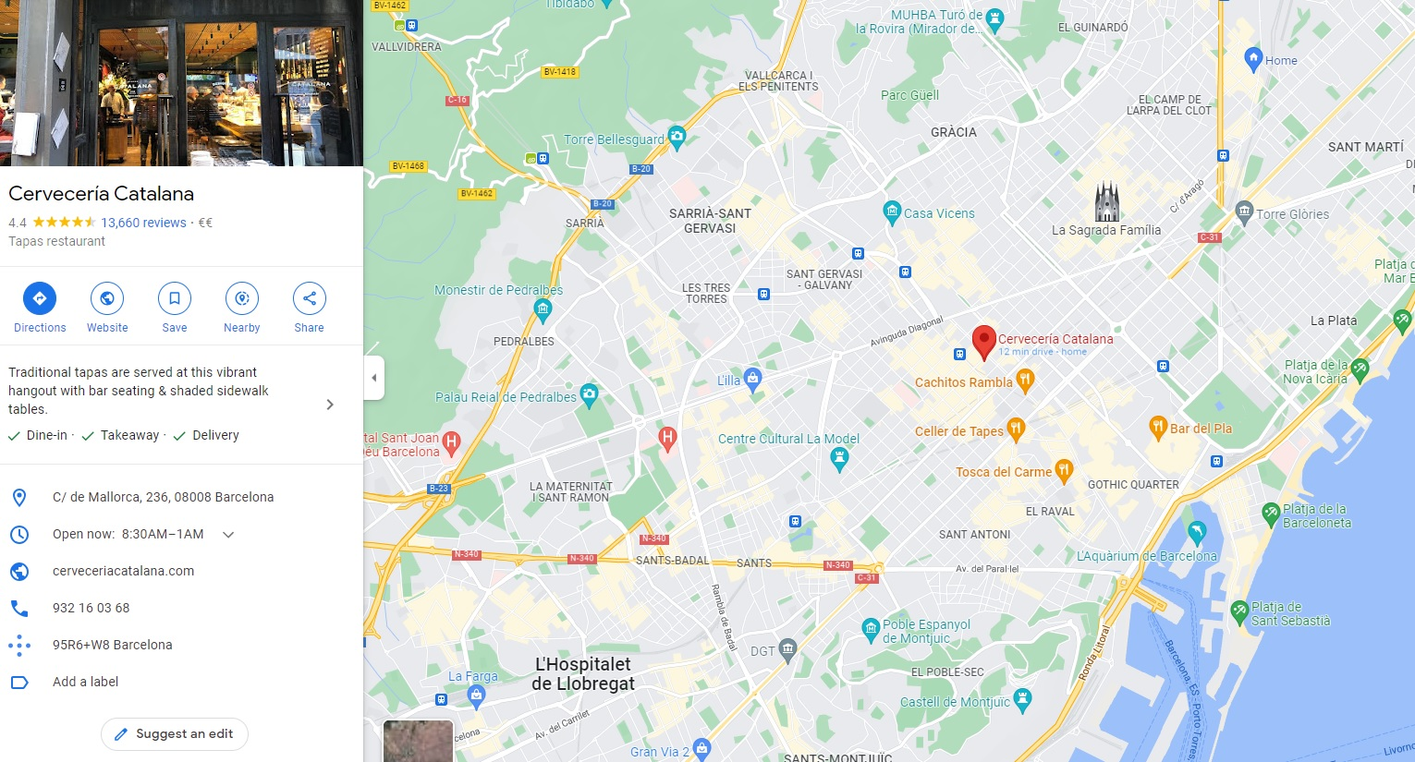
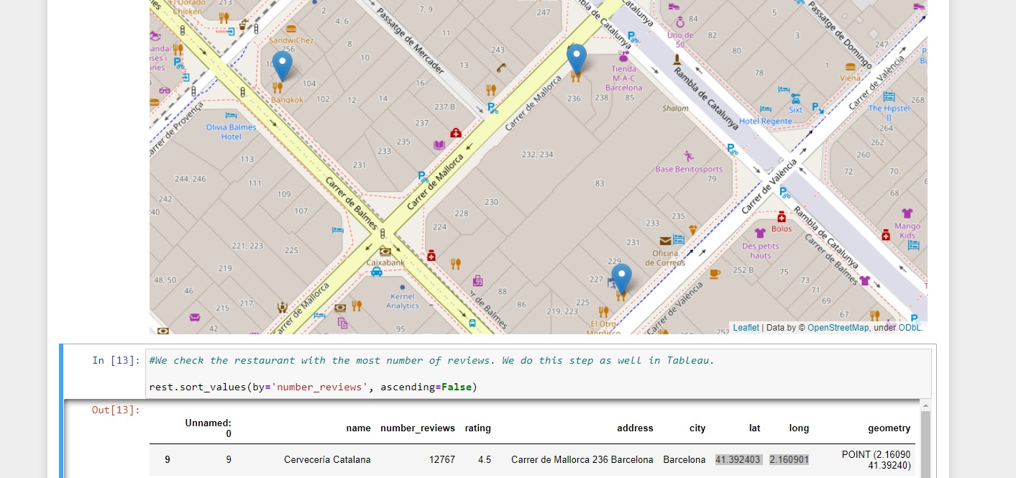
Location

Slide 11
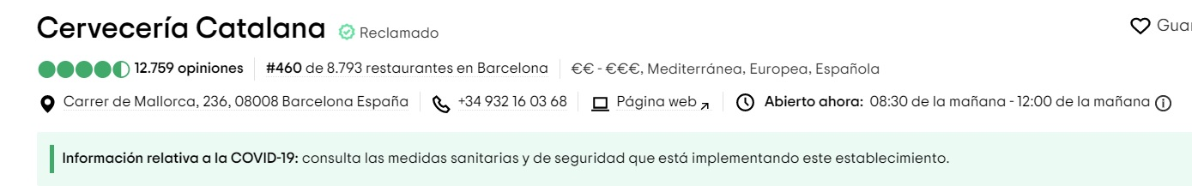
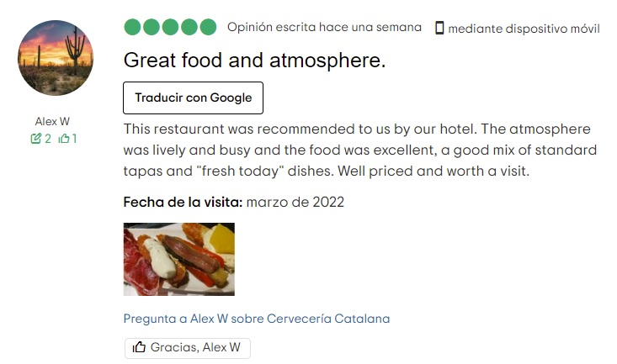
Webscraping

Slide 12
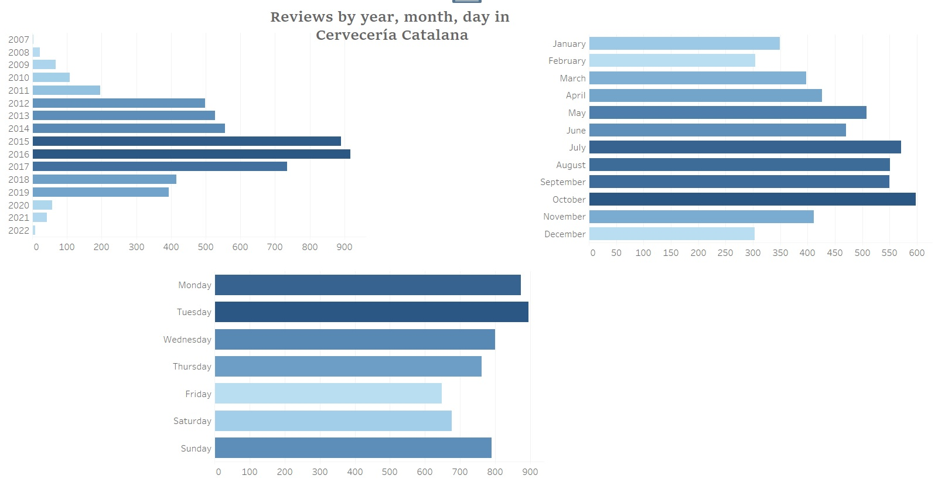

Slide 13
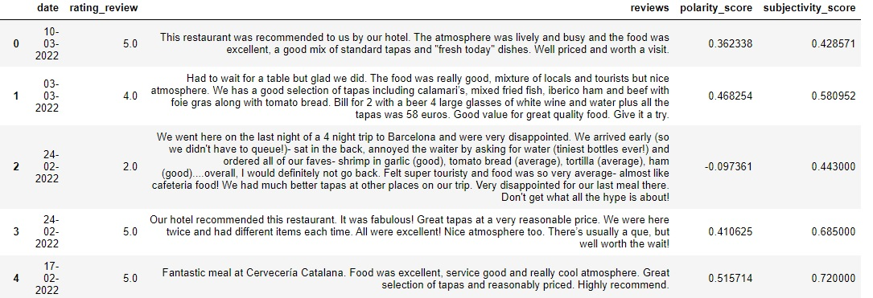
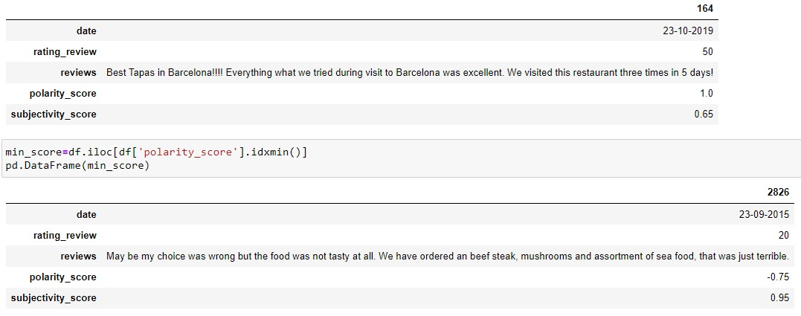
Sentiment Analysis
Polarity and Subjectivity of reviews
Mean Polarity: 0.33 --- 66,5% positive
Mean Ratings: 4.43 --- 88,6% positive

Slide 14
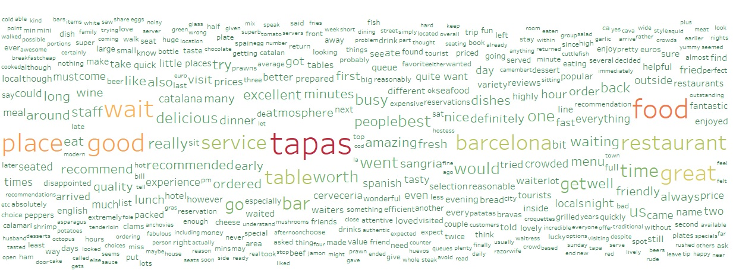
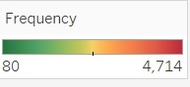
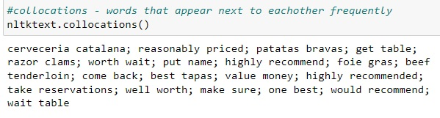
Lexical Analysis
Most frequency words in the reviews

Slide 15
Conclusions
The major density of restaurants in Barcelona are in the neighborhood "la Dreta de l'Eixample", and the neighborhoods that surround it.
The general rating in Barcelona is about 4 of 5 stars, which means a notable score.
Reviews from Cervecería Catalana, overall, have a positive general trend, due to mean ratings from the total number of reviews posted as well as indicates the mean of the polarity obtained in the Sentiment Analysis.
Cerveceria Catalana is a recommendable restaurant for most of the people.

Slide 16
Thank you!

